Slide 1
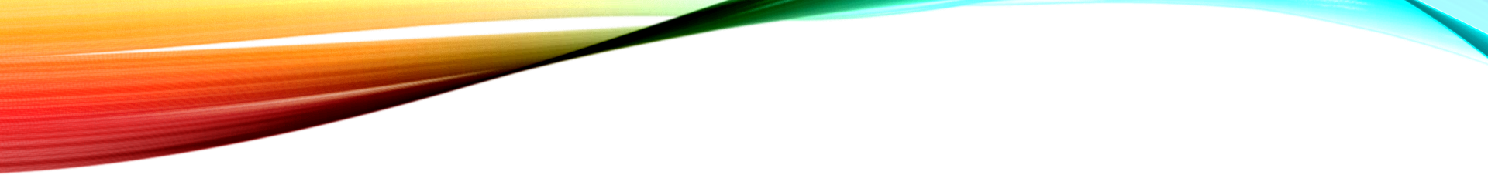
The Pathway of Blood Flow Through the Heart, Animation.
What is CMR ():
Advantages of CMR:
Widespread Availability,
High Temporal and Spatial Resolution,
No ionizing radiation.
Limitation:
Lack of dependable quantitative analysis (p1R1)
https://www.youtube.com/watch?v=BEWjOCVEN7M

Slide 2
The Pathway of Blood Flow Through the Heart, Animation.
How to estimate blood flow in the heart muscle
By injecting a material called gadolinium into the bloodstream,
and then by taking a sequence of MRI images
2. The problem: MRI signal is not directly proportional to gadolinium concentration
The MRI scanner measures signal intensity, not the actual concentration of gadolinium. Unfortunately, the relationship between these two is not perfectly linear, especially at higher gadolinium levels. This causes “signal saturation” — the signal stops increasing even though the gadolinium concentration is still rising.
This is a big problem for quantitative analysis (when we want to calculate actual blood flow values in mL/min/g), because it makes the math inaccurate — particularly in the blood pool, where the gadolinium concentration is highest during the first pass.
3. How to fix the signal saturation problem
Researchers have developed two main strategies to minimize or correct this saturation:
a) Dual-bolus technique
They inject two doses of gadolinium:
The first small bolus (about one-tenth of the normal dose) is used to measure the arterial input function (AIF) — the concentration of contrast entering the heart.
The second larger bolus is used to measure the myocardial tissue response — how the heart muscle itself enhances.
The two measurements are then mathematically aligned and scaled to one another so that the AIF curve (from the small dose) matches the tissue enhancement (from the big dose).
b) Dual-sequence technique
Instead of two injections, the MRI scanner captures two types of images during one injection:
Low-resolution, low-sensitivity images of the blood pool (which handle high contrast concentrations without saturating).
High-resolution, high-sensitivity images of the myocardium.
This method avoids the need for two separate injections and keeps the timing between AIF and tissue signals perfectly aligned.

Slide 3
The Pathway of Blood Flow Through the Heart, Animation.
4. How myocardial blood flow is calculated
Once the signal-intensity curves are corrected, researchers can estimate the true gadolinium concentrations over time and use mathematical models to compute MBF.
There are two main modeling approaches:
a) Tracer-kinetic (blood-tissue exchange) model
It treats the heart as two compartments:
Blood inside the vessels.
The tissue space around the vessels.
Gadolinium moves between these two spaces through a thin barrier (the capillary wall).
By adjusting model parameters, the program can estimate how much blood is flowing and how fast gadolinium diffuses.
b) Deconvolution approach (based on the central volume theorem)
This is simpler and is the one you’ll use in your assignment.
It assumes that the tissue signal curve is the convolution of the input (AIF) with the tissue impulse response (how the tissue reacts to a short burst of contrast).
By deconvolving the tissue curve with the AIF, we recover that impulse response.
The height (amplitude) of this impulse response at time zero represents the blood flow through that tissue.
Because deconvolution is a mathematically unstable process (small noise can cause large errors), researchers often constrain it using a model such as the Fermi function, which provides a smooth and physiologically realistic shape for the response curve.
5. The key takeawayThis section emphasizes that:Gadolinium-enhanced MRI can, in theory, provide absolute quantitative measurements of blood flow in the heart.However, to get accurate results, one must correct for signal saturation and use robust mathematical models (like the Fermi function deconvolution).These improvements are what make stress perfusion CMR a promising, noninvasive alternative to nuclear methods like PET and SPECT for assessing coronary artery disease.

Slide 4
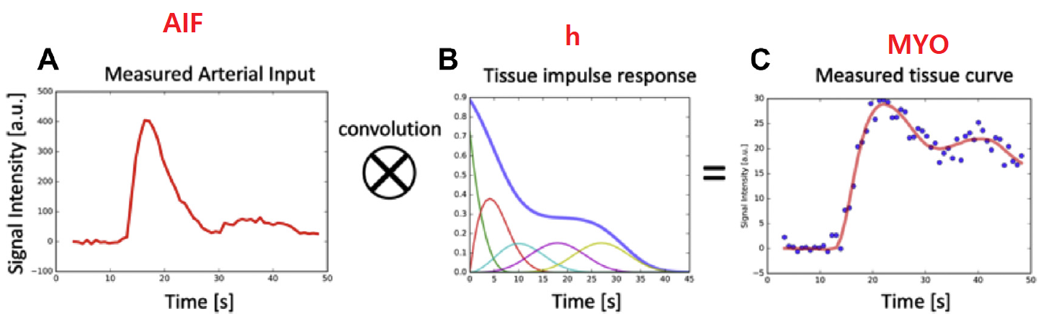
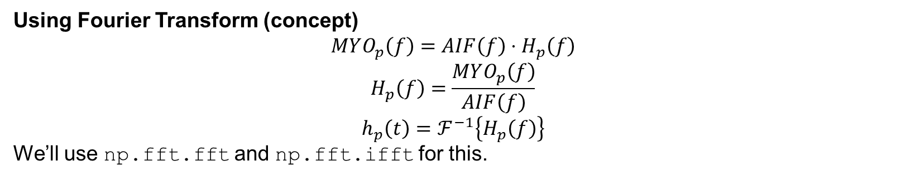
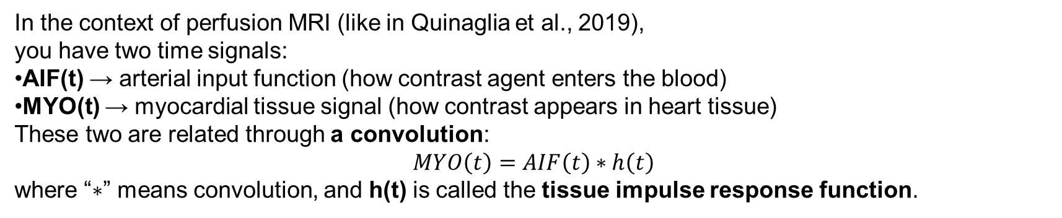
The Pathway of Blood Flow Through the Heart, Animation.
In the context of perfusion MRI (like in Quinaglia et al., 2019), you have two time signals:
AIF(t) → arterial input function (how contrast agent enters the blood)
MYO(t) → myocardial tissue signal (how contrast appears in heart tissue)
These two are related through a convolution:
$$MYO\left(t\right)=AIF\left(t\right)∗h\left(t\right)$$
where “$∗$” means convolution, and h(t) is called the tissue impulse response function.
To find $h\left(t\right)$, you need to undo the convolution, which is called deconvolution.
Using Fourier Transform (concept)
$$MYO_{p}\left(f\right)=AIF\left(f\right)⋅H_{p}\left(f\right)$$
$$H_{p}\left(f\right)=\frac{MYO_{p}\left(f\right)}{AIF\left(f\right)}$$
$$h_{p}\left(t\right)=ℱ^{−1}\left\{H_{p}\left(f\right)\right\}$$
We’ll use np.fft.fft and np.fft.ifft for this.

Slide 5
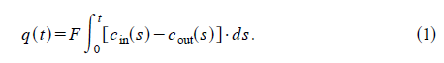
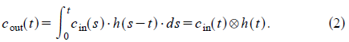
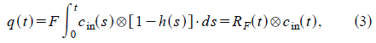
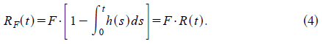
The Pathway of Blood Flow Through the Heart, Animation.
the amount of tracer in the ROI at any time, q(t), is simply the difference between the amount of tracer that was washed in and washed out.
F is the rate of flow
R(t) represents the probability that a tracer molecule remains in the ROI up to time t.
The shape of the tissue impulse response, R(t), can be approximated with a Fermi function.

Slide 6
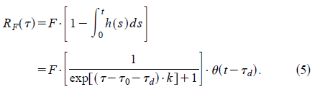
The Pathway of Blood Flow Through the Heart, Animation.
The analytical expression for the Fermi function model is:
u (t2t d), a unit step function, equals 0 for t<t_d and 1 for t>t_d

Slide 7
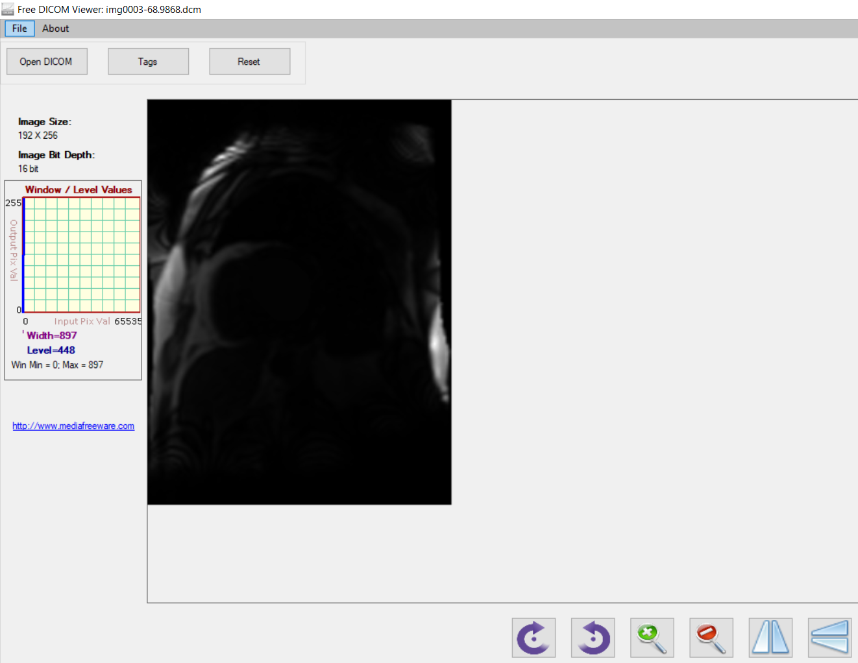
The Pathway of Blood Flow Through the Heart, Animation.

Slide 8
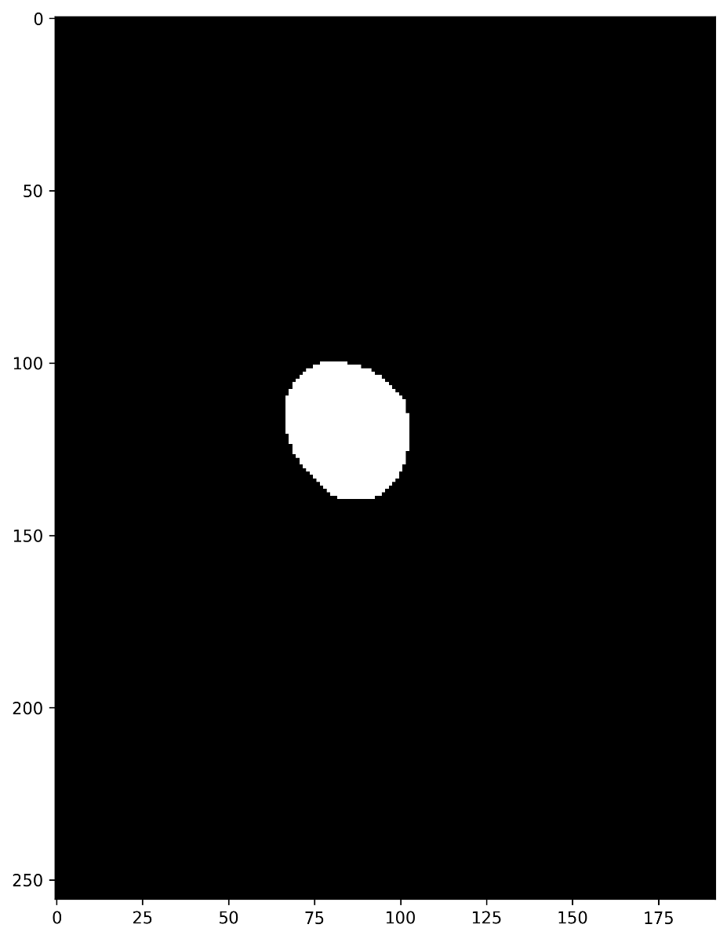
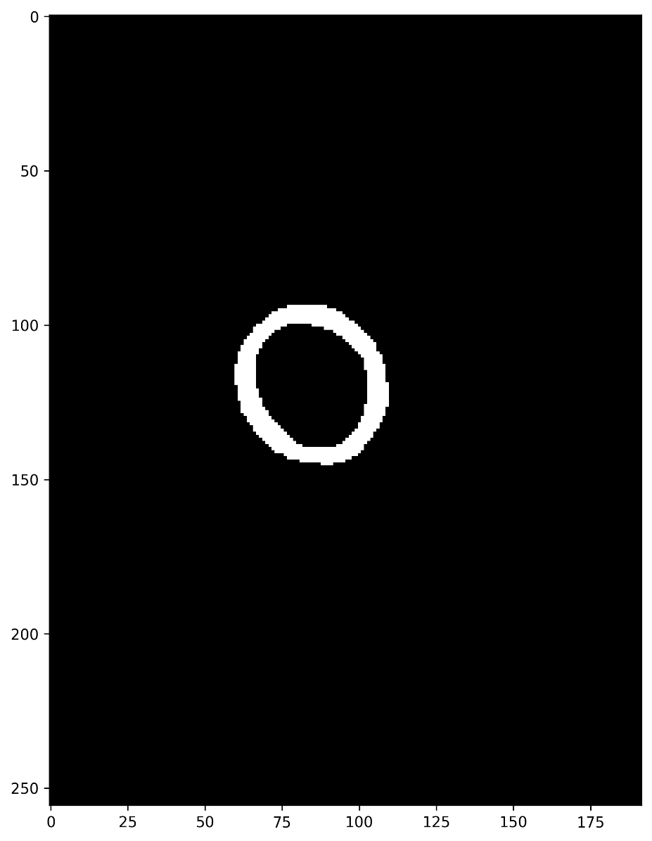
The Pathway of Blood Flow Through the Heart, Animation.

Slide 9
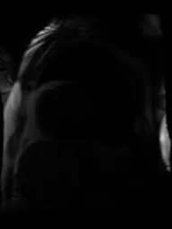
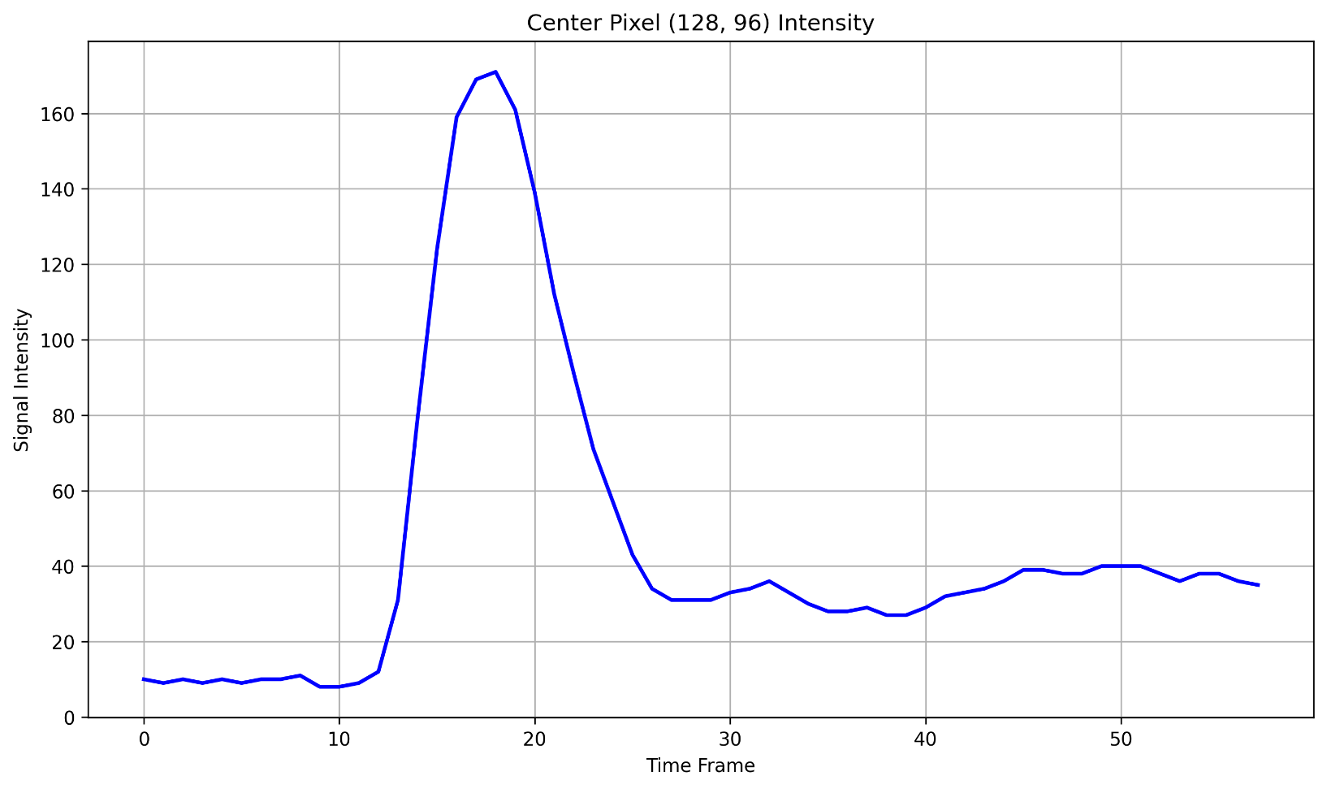
The Pathway of Blood Flow Through the Heart, Animation.

Slide 10
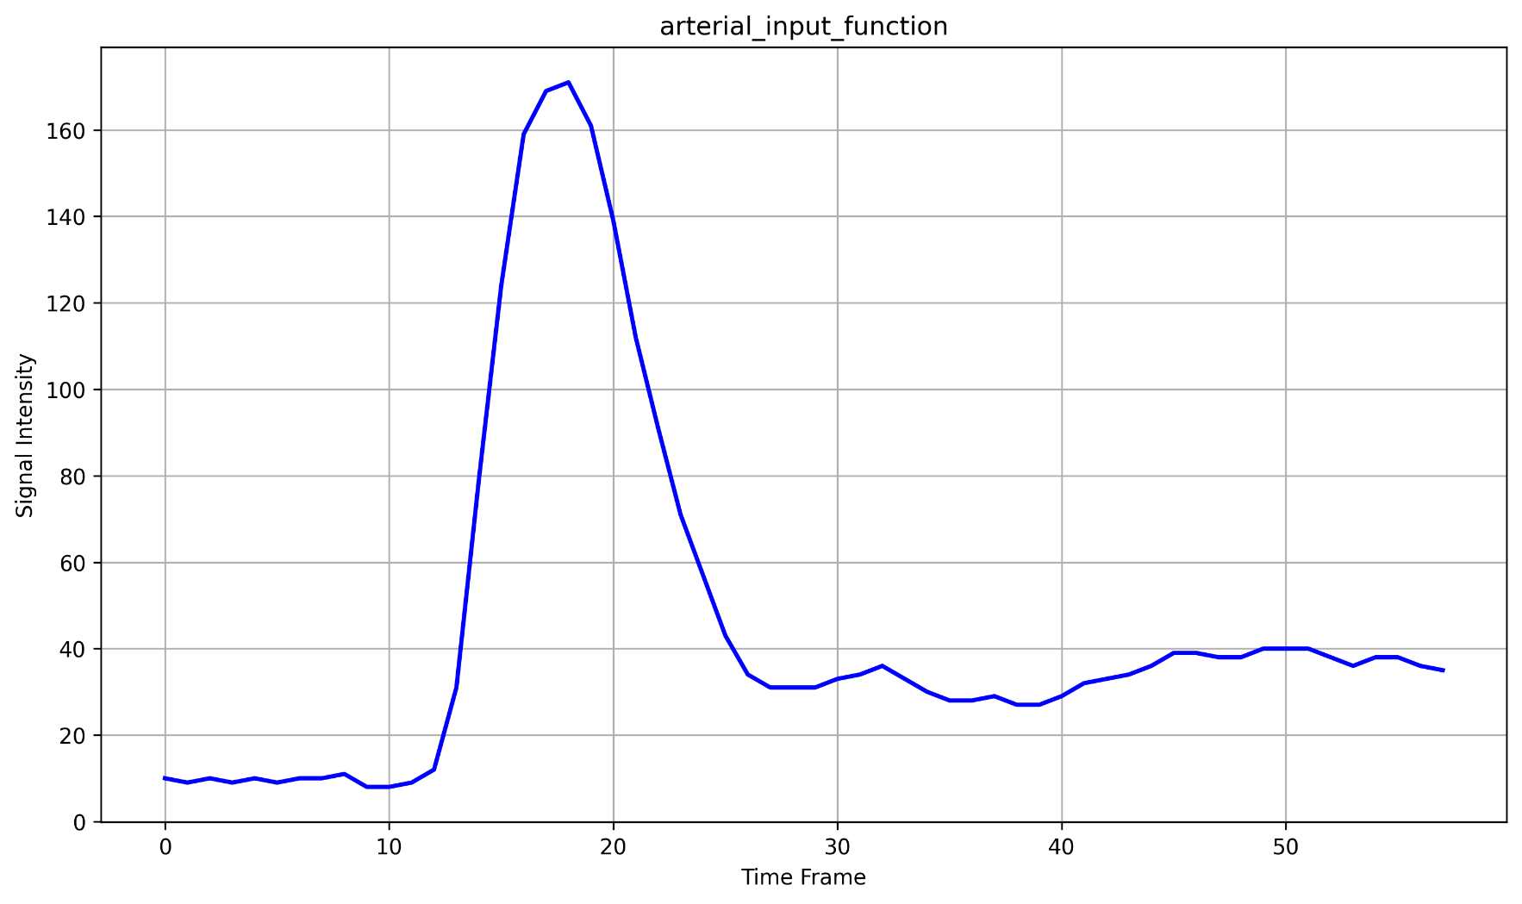
The Pathway of Blood Flow Through the Heart, Animation.

Slide 11
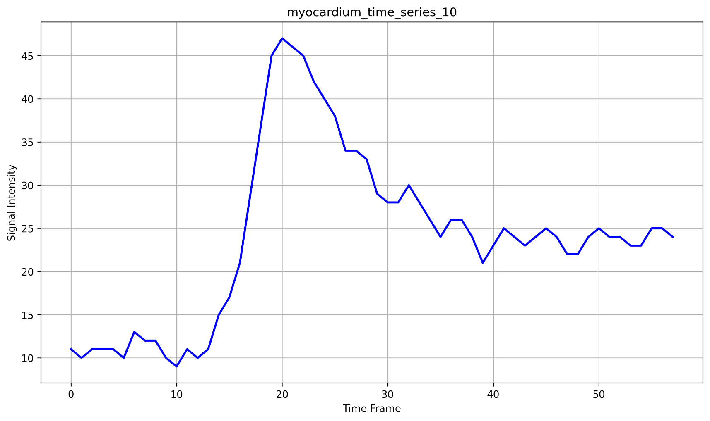
The Pathway of Blood Flow Through the Heart, Animation.

Slide 12
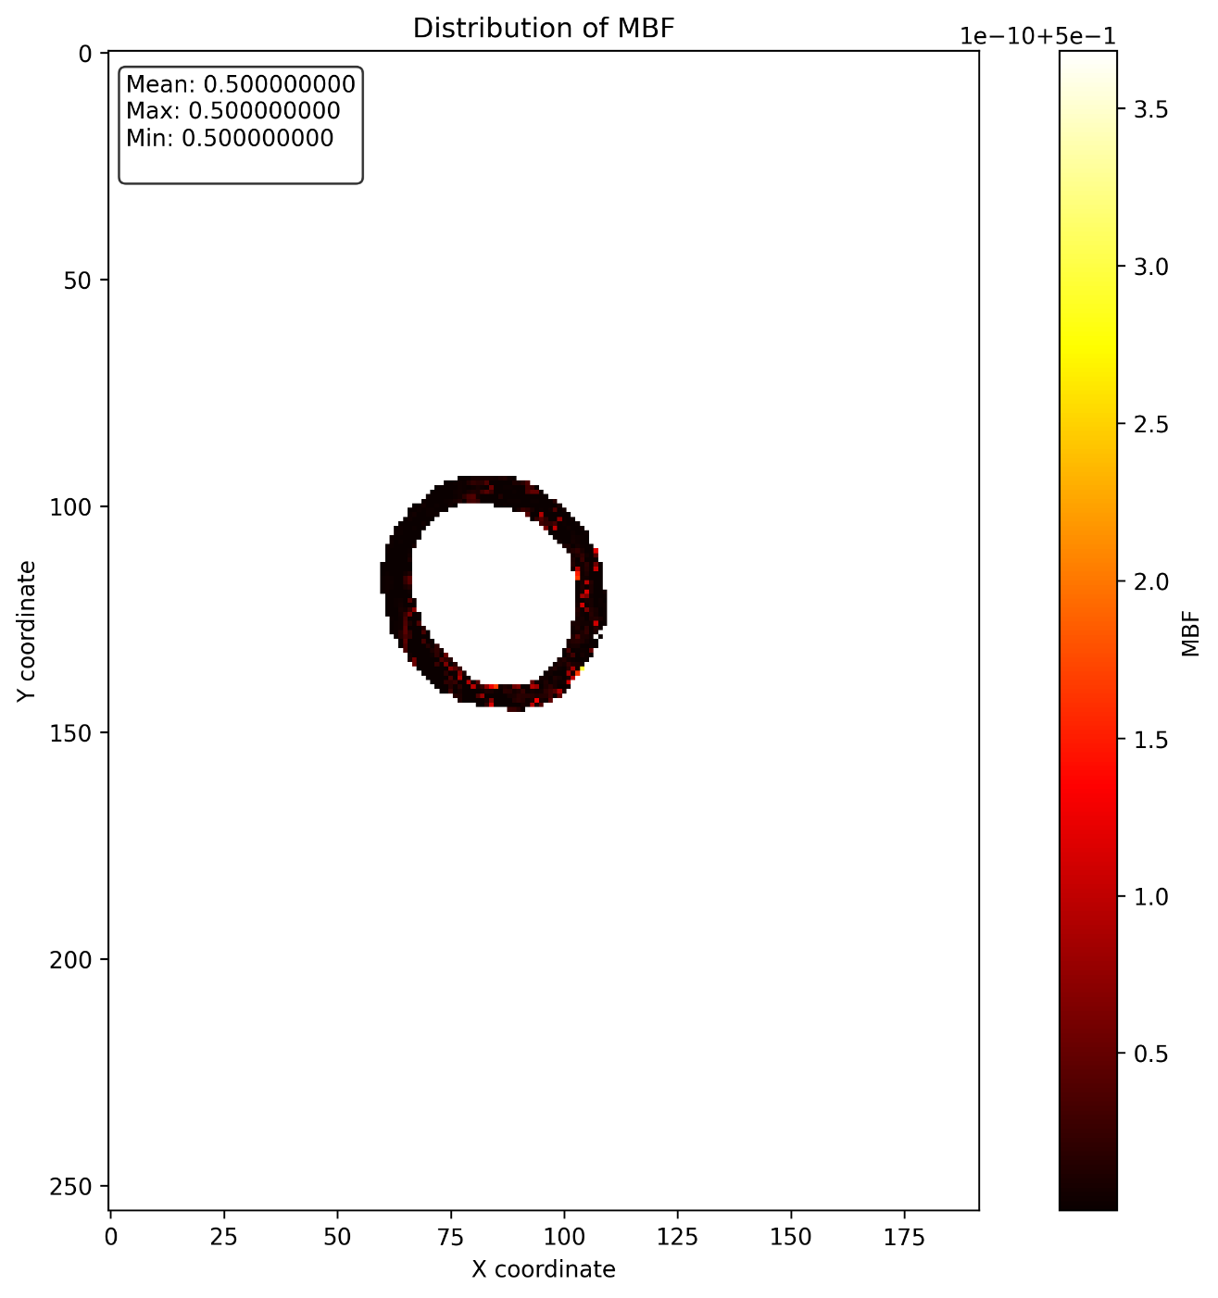
The Pathway of Blood Flow Through the Heart, Animation.

Slide 13
The Pathway of Blood Flow Through the Heart, Animation.

Slide 14
The Pathway of Blood Flow Through the Heart, Animation.

Slide 15
The Pathway of Blood Flow Through the Heart, Animation.

Slide 16
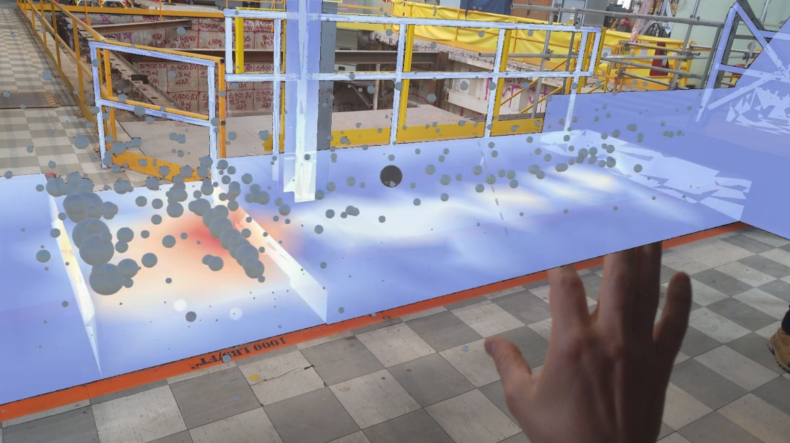
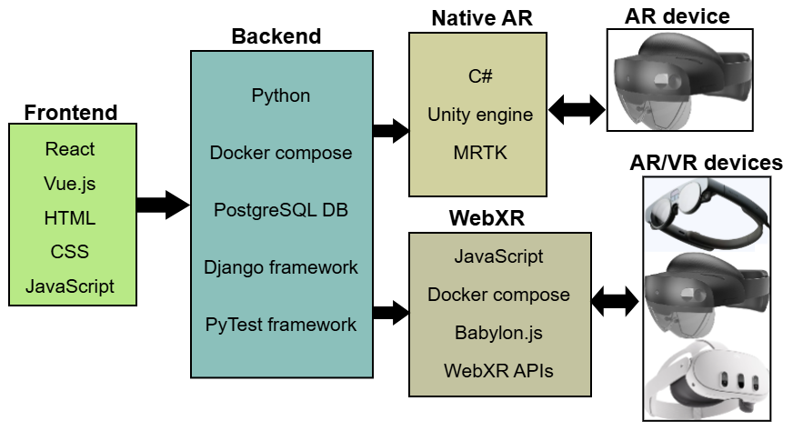
Second Postdoc: 2023-Present
Radiation field visualization in nuclear facilities using AR and VR technologies

Slide 17
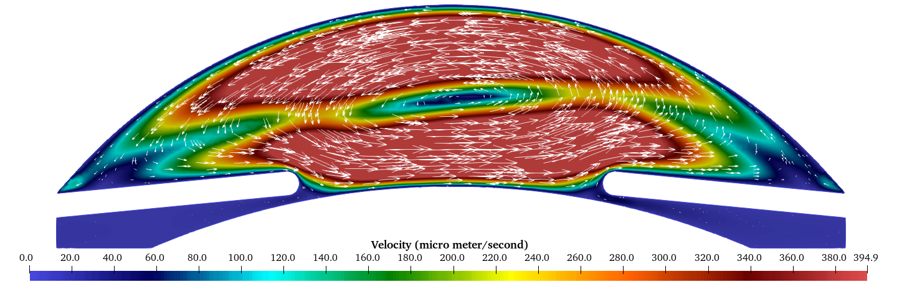
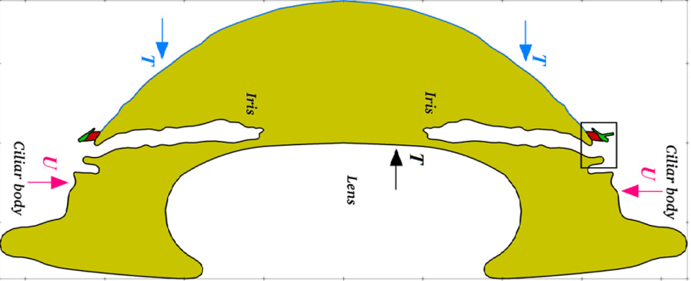
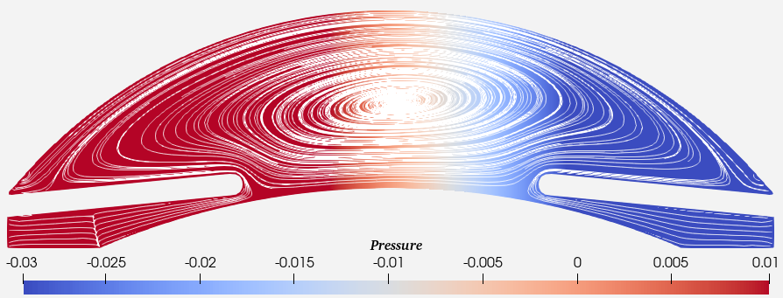
First Postdoc: 2022-2023
Modeling tritium movement through human eye lens in computational framework.

Slide 18
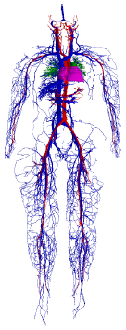
Ph.D. project
An algorithm for the lattice Boltzmann method adapted to sparse geometries and distributed memory systems
Fluid flow simulation software
Developed C++ code
Worked on super computers
Modified an algorithm
Developed 2 algorithms along with implementation in C++
To simulate the full human vessels, around 1.6 billion nodes are required

Slide 19
Working period in Iran
C++/Python
Scientific computation software
Fluid flow simulation software
Geometry optimization
Parallel programming using MPI, OpenMP, CUDA
About 100,000 lines

Slide 20
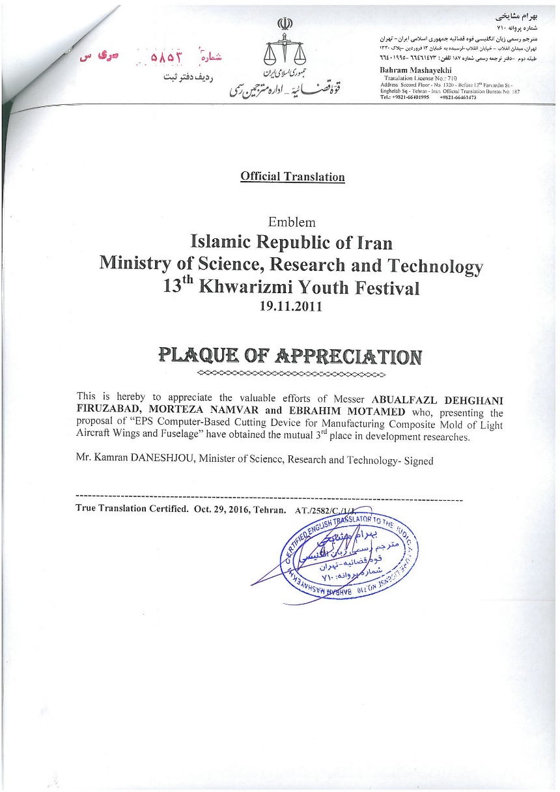
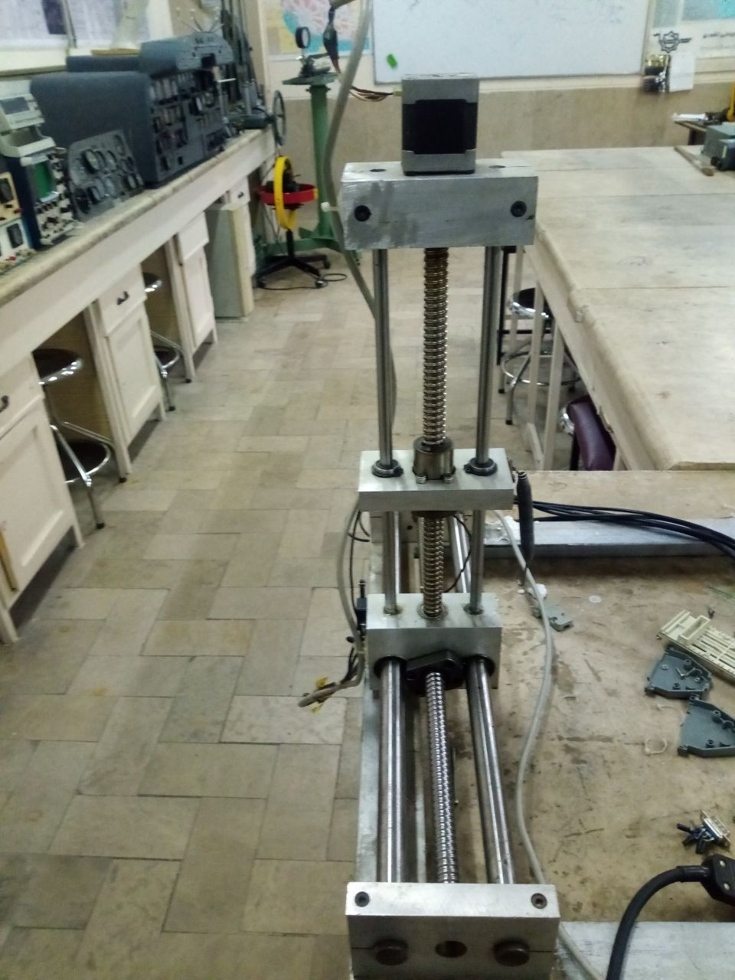
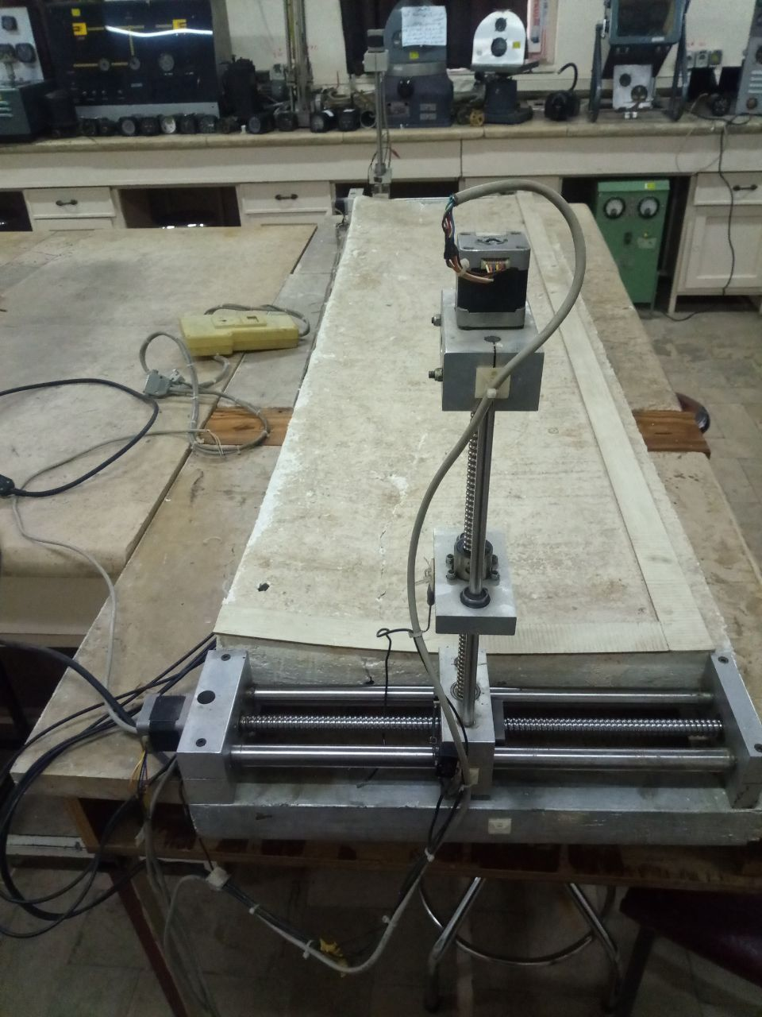
My invention:

Slide 21
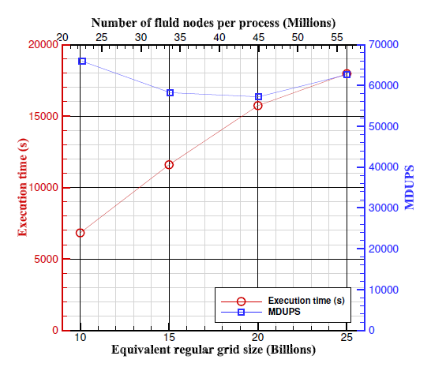
The biggest problem I solved by the developed code:

